Slide 1

Air Canvas
Team Python thinkers

Slide 2

Team Members
Anto Francis (C0825095)
Omer Volkan Guney (C0831373)
Rupesh Chandran (C0826779)
Sachin Sreekumar (C0825096)
Reporting Week: Feb 27, 2022 to Mar 12, 2022
Supervised by
Prof. Parissa Naraei

Slide 3
Week’s update
Identified the contours from the mask
Created data structure for storing pixel points for each colors
Identified the biggest contour from the list and marked it using a circle.

Slide 4
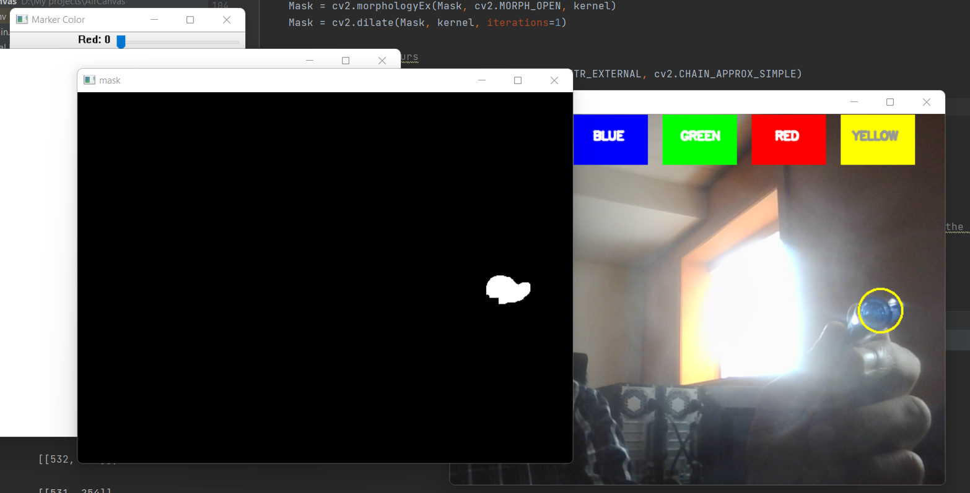
Masking

Slide 5
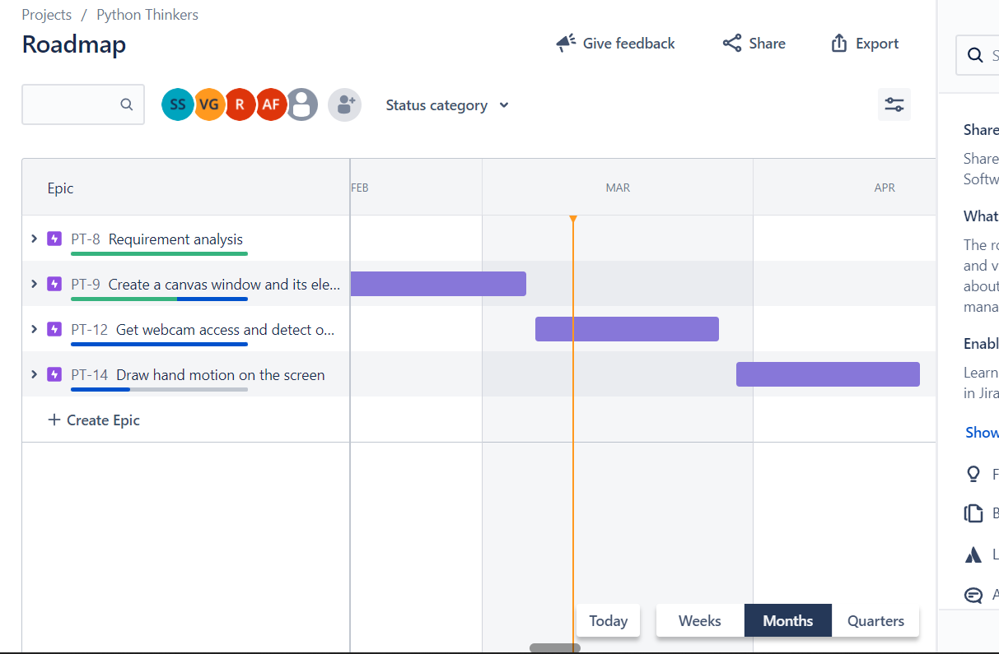
Week’s update
Third phase of the project is completed. Starting the last phase from next week.

Slide 6
Challenges/Learnings this week
Removal of noise from the contours
Finding the right HSV values for colors

Slide 7
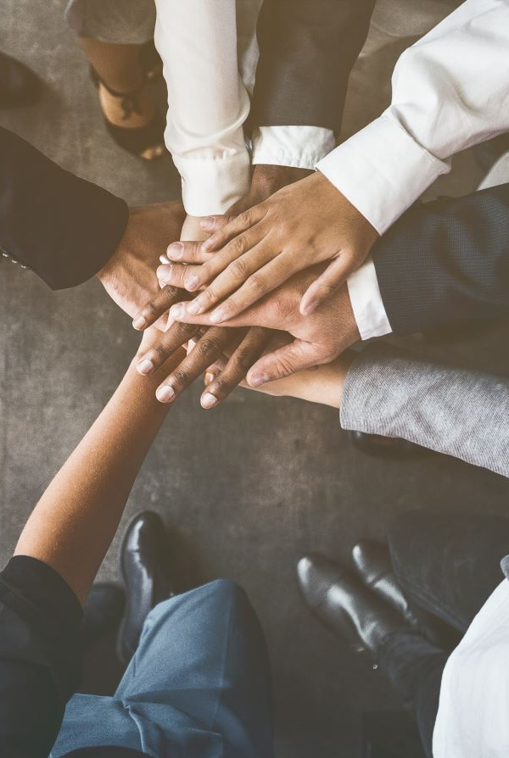
Team collaboration
Researched about HSV color values
Code reviews were done

Slide 8
Task outline for next week
Setting the point in contour to draw the pixel on the screen.
Selection of color by pointing on the color boxes on top of the screen.

Slide 9

Thank you

